Slide 1


BRAND NEW ECO-PRODUCT
REUSABLE WATER BOTTLE
A11.2021.13254
PRESENTATION BY DIMAS PRATAMA

Slide 2
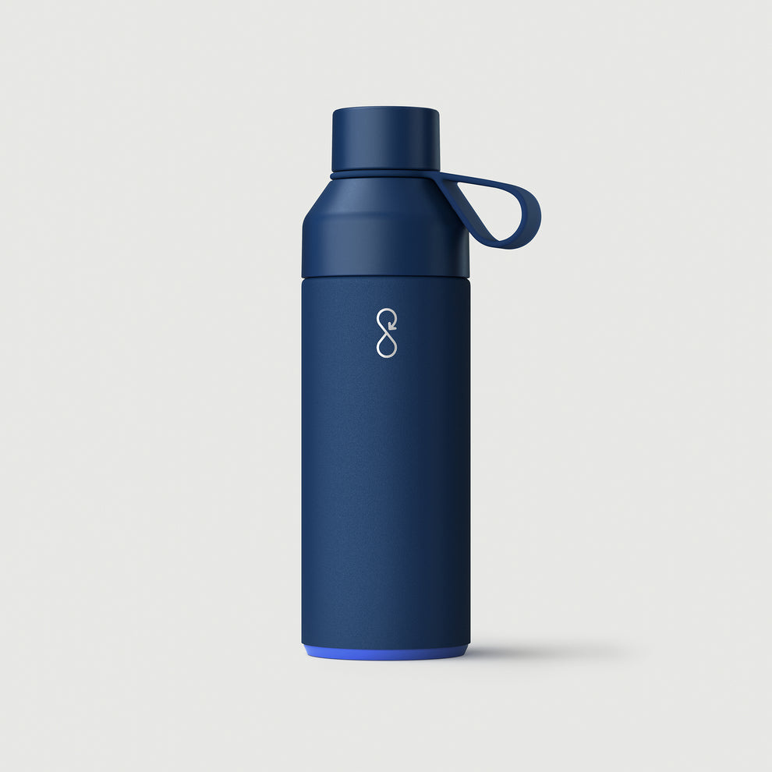
INTRODUCTION
Stainless Steel Reusable Water Bottle is the perfect companion for your active and eco-conscious lifestyle.
Crafted with precision and sustainability in mind, this sleek and durable water bottle is designed to make a positive impact on your hydration routine.
Our reusable water bottles are designed to provide a convenient and stylish alternative, encouraging individuals to make a positive impact on the environment by reducing plastic waste.
PAGE 02

Slide 3
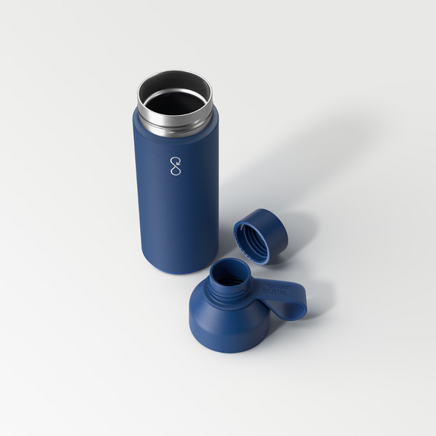
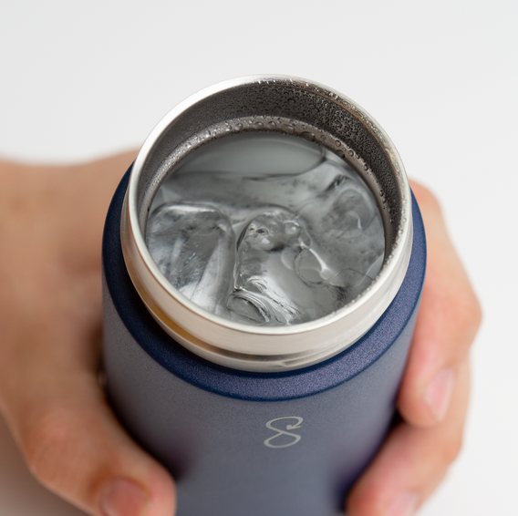
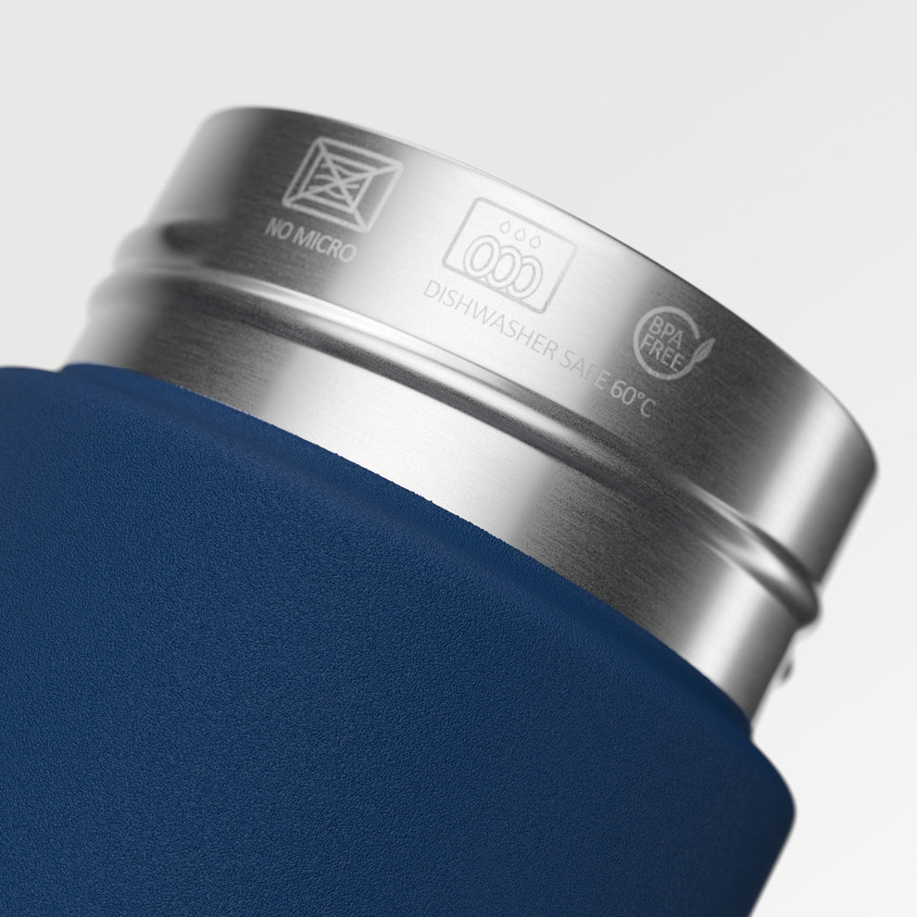
OVERVIEW
Reusable water bottles are meticulously crafted from BPA-free material, food-grade stainless steel, and prioritizing consumer well-being. The absence of Bisphenol A eliminates potential health concerns associated with plastics, ensuring customer safety.
The use of corrosion-resistant food-grade stainless steel maintains product integrity, preventing flavor transfer and preserving the purity of stored liquids.
PAGE 03

Slide 4
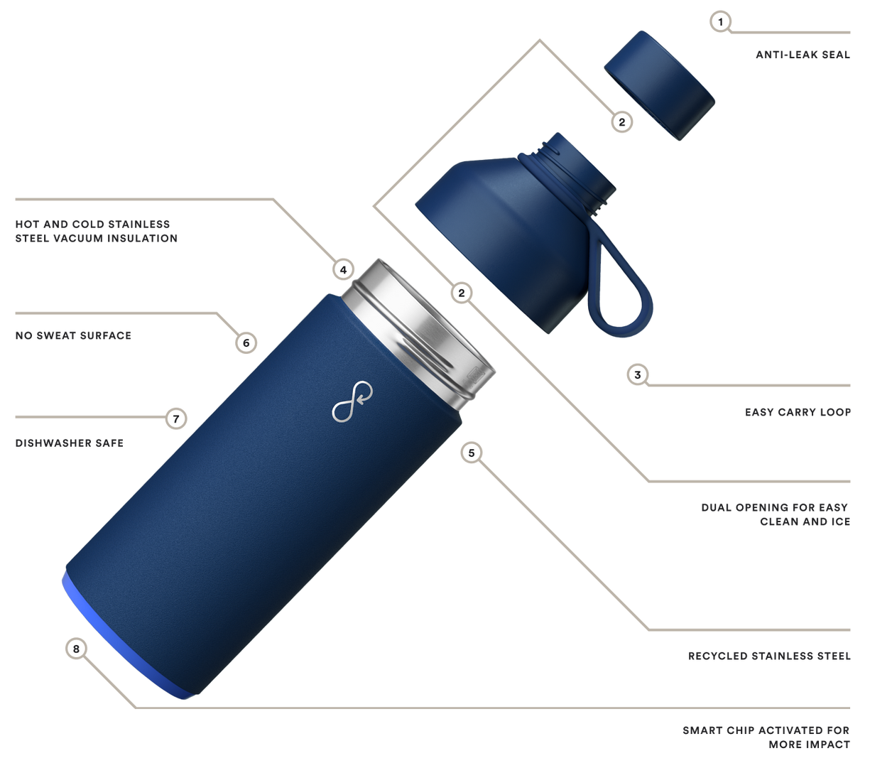
OUR COMMITMENT
We are committed to high-quality and safe materials not only supporting environmental sustainability but also prioritizing the health and satisfaction of our customers.
PAGE 04

Slide 5
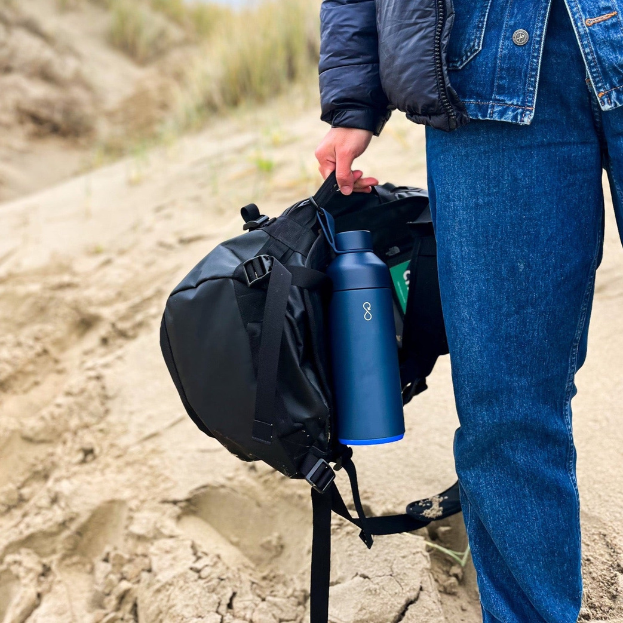
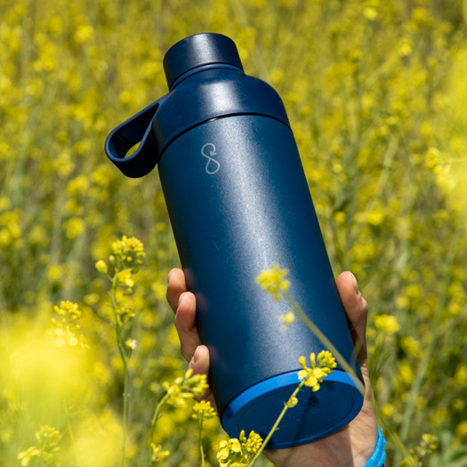
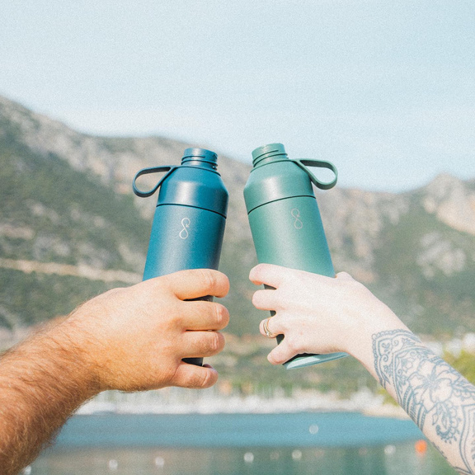
FOR WHO?
Our reusable water bottles cater to a diverse range of consumers such as students, office workers, travelers, outdoor enthusiast likes: hikers, campers, runners, and other.
PAGE 05

Slide 6
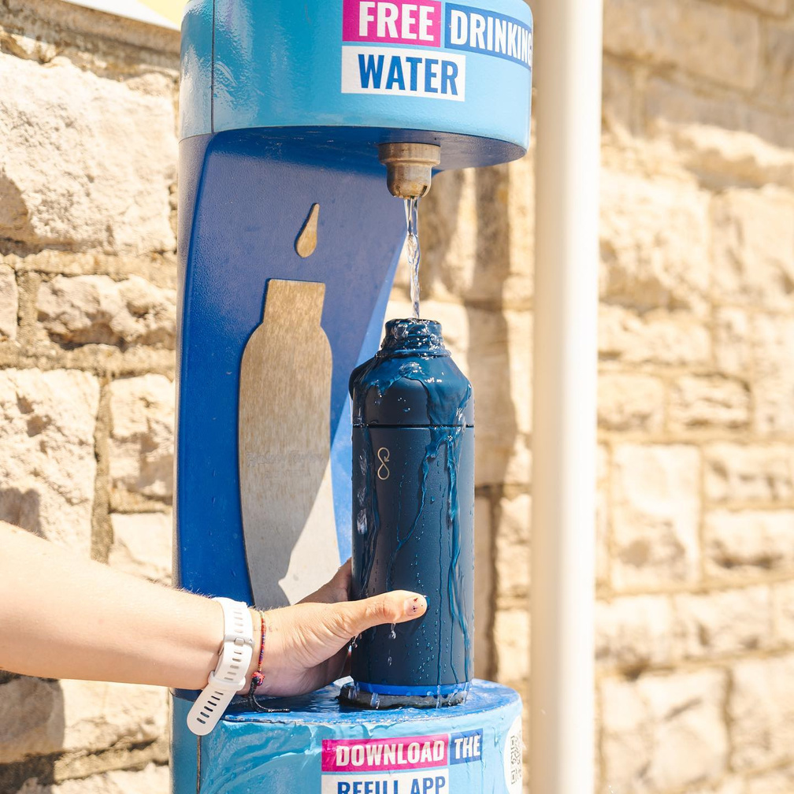




WHY US?
Owning an Reusable Water Bottle is more than just a commitment to only using non plastic water bottles. It’s more than only ever filling up your refillable water bottle instead of buying bottled water. It’s more than sharing your love for a stylish B Corp certified eco water bottle made from recycled materials.
+62-817-4228-1004
www.ecofriendly.com
ecofriendly@gmail.com
176 Tlogosari St., Semarang City
PAGE 06

